Slide 1
AI-Driven Demand Prediction for Smarter Retail
Presented by:
M N S Sri Harshini

Slide 2
Introduction to the Project
Project Overview:
The AI-driven demand prediction project focuses on using advanced time series forecasting models to predict product demand for retail businesses, helping improve inventory management, optimize marketing efforts, and enhance customer satisfaction.
Objectives:
Using AI models to forecast demand for retail products based on historical sales data and external factors like Google Analytics.
Motivation:
Accurate forecasting allows businesses to manage stock levels more effectively, reduce overstock/stockouts, and improve customer satisfaction.

Slide 3
Data Sources & Overview
Data Description:
The dataset used includes historical sales data (target variable: Quantity) and external factors such as Clicks and Impressions (from Google Analytics and social media).
Target Variable: Quantity (sales data)
Exogenous Variables: Clicks, Impressions (external factors influencing demand)
Challenges included handling missing values and data cleaning.

Slide 4
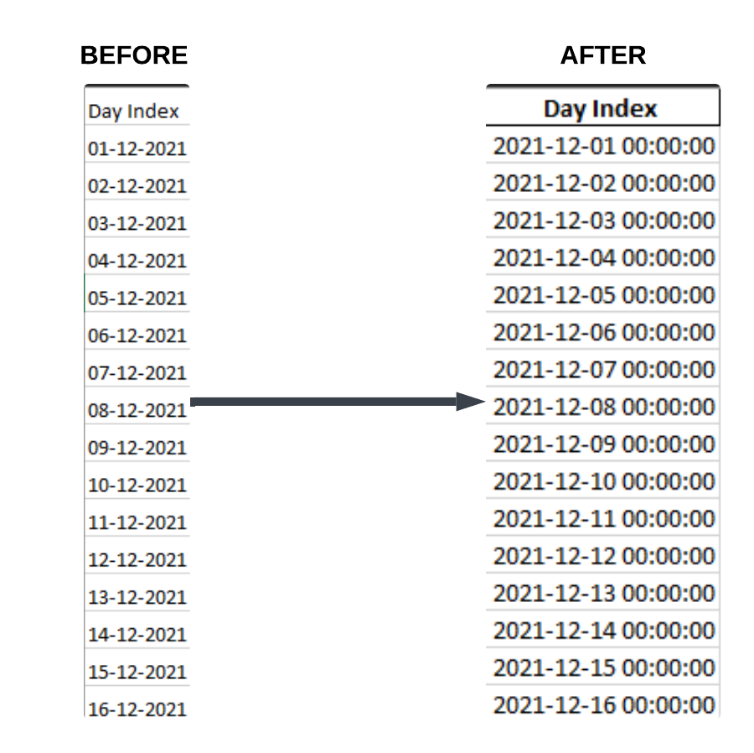
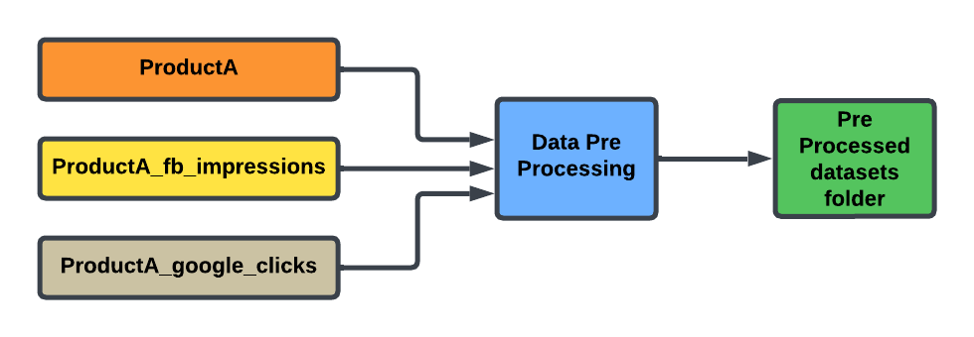
Step 1 : Data Pre Processing
Step 1: Convert the 'Day Index' column to a proper datetime format
Converting the 'Day Index' column to a proper datetime format ensures consistency, accuracy, and compatibility with date-based operations. It allows for easier analysis, time-based aggregations, and smooth data merging or filtering, while preventing errors or mismatches due to incorrect date formats.
Step 2: Remove duplicate rows There were no duplicate rows in the dataset, so this step was not necessary.
1
Step 3: Fill any missing values using forward fill There were no missing values in the dataset, so this step was not needed.
2
Final Step :Output Data
3
Cleaned datasets are saved into the pre_processed_datasets folder, ready for merging.
4

Slide 5
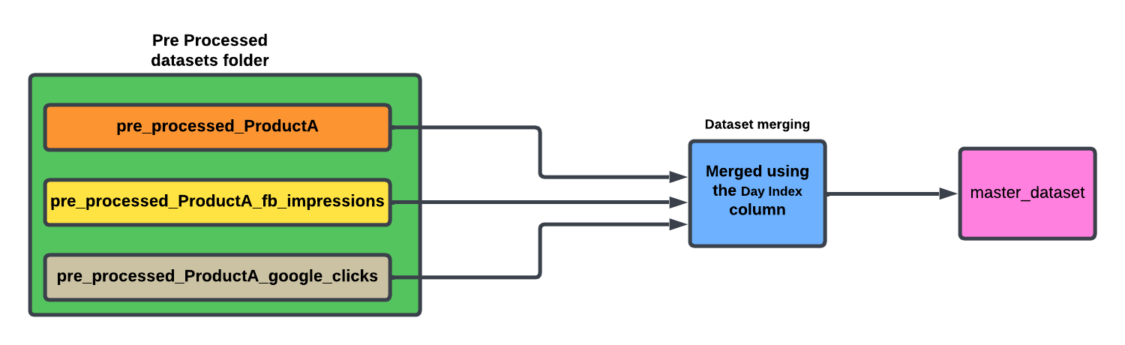
Step 2 : Dataset Merging
The process involves loading preprocessed datasets from the pre_processed_datasets folder, merging them based on the common column Day Index, and saving the final merged dataset to the master_dataset folder.

Slide 6
Step 3: Data Analysis and Visualization
Why This: The code is essential for analyzing the Master Dataset, as it transforms raw data into actionable insights. It helps uncover trends, correlations, and key metrics crucial for making informed decisions in the project.
Purpose of this code:
Feature Engineering: It calculates vital metrics such as Click-Through Rate (CTR), Conversion Rate, and Sales per Click, which enhance data comprehension.
Data Cleaning: The code addresses missing values and infinities, ensuring that calculations and visualizations are robust and reliable.
Visualizations: A series of plots and charts are generated to highlight relationships, growth patterns, and insights in the data, making it easier to identify trends over time.
Key Takeaways and Conclusion: This code allows us to analyze and visualize key performance metrics, track trends over time, and identify factors influencing sales. It is a crucial step in understanding data, making it more actionable, and supporting better decision-making for demand prediction and business planning.

Slide 7
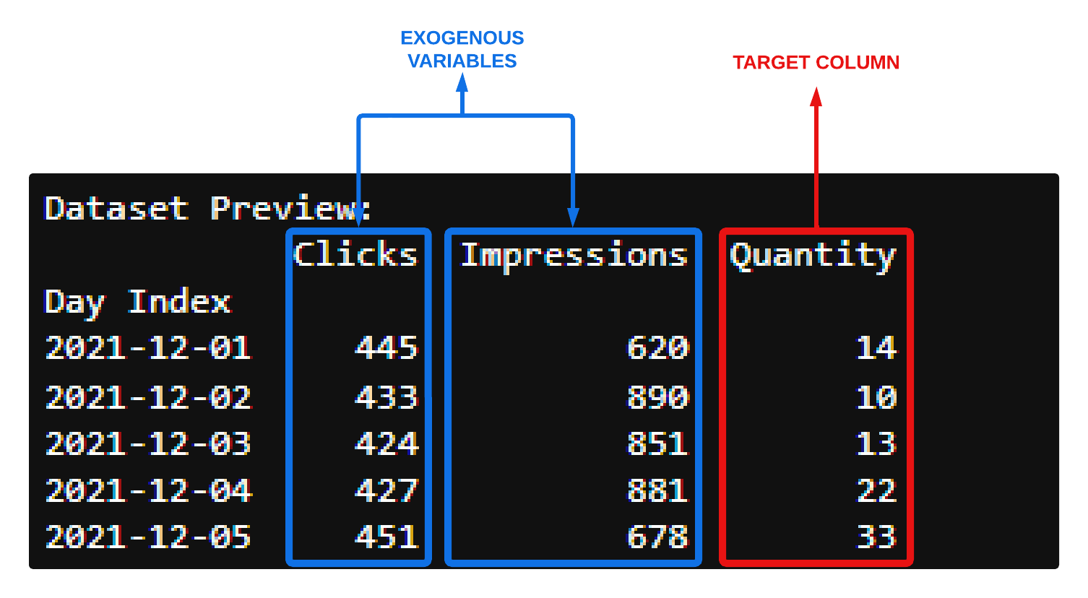
Step 4 : Dataset Loading and Preparation
Loaded the dataset using pandas (read_excel) and ensured correct file path.
Key columns: Quantity, Clicks, and Impressions.
Set the Day Index to organize the data in time series format for forecasting.
Exogenous Variables: Identified and processed Clicks and Impressions to influence the target variable Quantity.
Data Alignment: Ensured matching number of observations between target and exogenous variables for consistency in the forecasting model.

Slide 8
Stationarity Check and Data Preparation
Stationarity Check and Data Preparation
Objective: Ensured the stationarity of the target column Quantity (required for time series modeling).
Steps Taken:
ADF Test: Performed the Augmented Dickey-Fuller (ADF) test to check if the series was stationary.
Dickey-Fuller Test Statistic: -4.38
p-value: 0.00025 (indicating that the series is stationary as p ≤ 0.05).
Differencing: Since the series was stationary, no differencing was required. (If the series had been non-stationary, first-order differencing would have been applied.)
Outcome:
The target series (Quantity) passed the stationarity test and was ready for further analysis.
Exogenous variables were adjusted to match the transformed target series.

Slide 9
Implementing Time Series Models
Objective : Implement various time series forecasting models to predict the target variable Quantity.
Models to be Implemented :
Autoregression (AR)
Moving Average (MA)
ARIMA
SARIMA
ARIMAX
SARIMAX
Goal :
Understand Model Performance: Analyze how well each model captures patterns, trends, and seasonality in the data.
Evaluate External Variables: Assess the impact of external factors (Clicks and Impressions) using models like ARIMAX and SARIMAX.
Select the Best Model: Use performance metrics such as Mean Squared Error (MSE) ,R-squared (R²) to identify the most suitable model for demand prediction.
Outcome : The comparative analysis will help determine the best model for forecasting product demand in the FutureCart project.

Slide 10
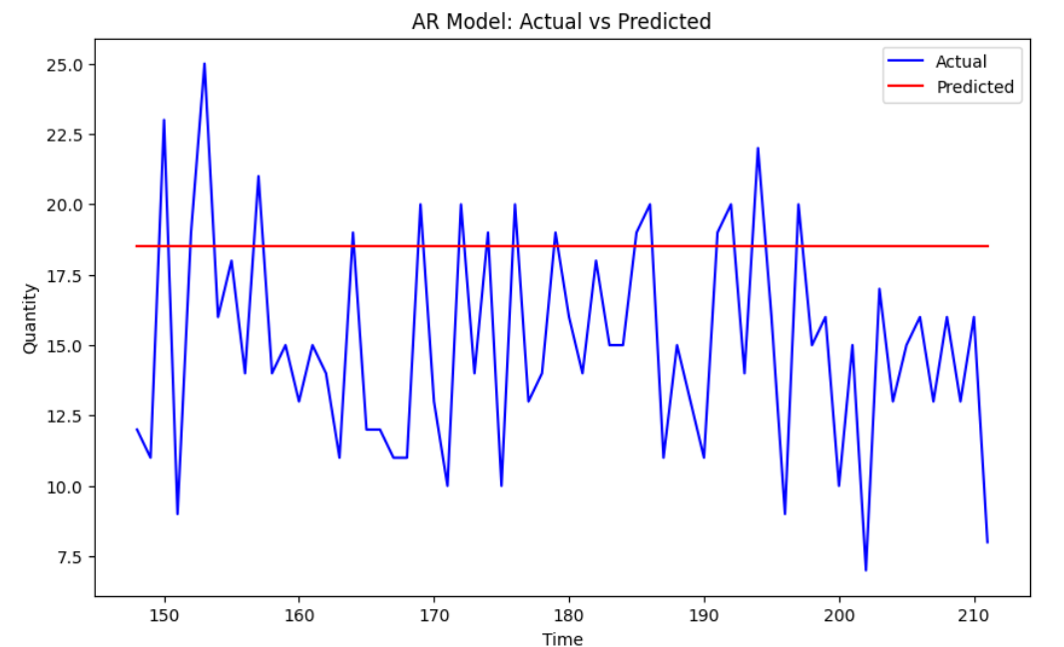
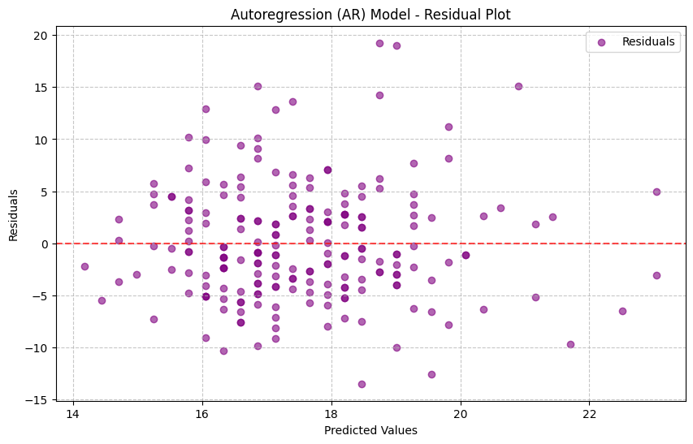
Model 1: Autoregression (AR)
The AR model effectively captures daily fluctuations in the time series but struggles with larger variations, showing discrepancies between actual and predicted values for certain periods.
The AR model has difficulty capturing longer-term trends, as evidenced by the differences between actual and predicted weekly values. The model does not fully account for the overall seasonality in the data.
The residual plot suggests that the model captures some patterns but also has significant outliers, indicating potential issues in the model’s ability to fully explain the data’s variance. Randomness in residuals is not ideal.

Slide 11
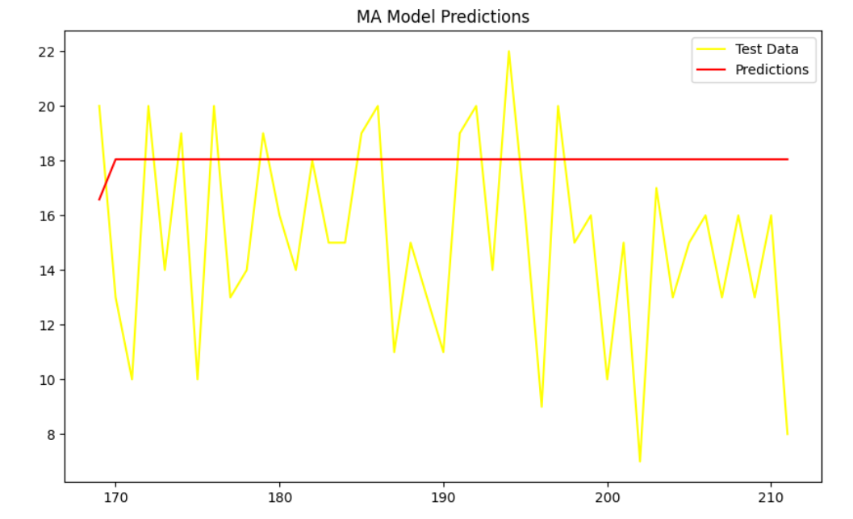
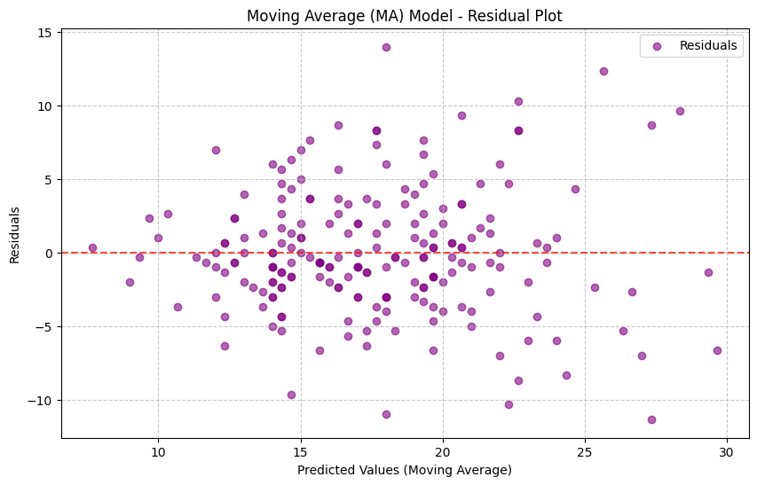
Model 2: Moving Average (MA)
The Moving Average (MA) model effectively smoothed the time series and identified short-term trends.
The original series and predicted values demonstrated how well the MA model captured these trends with a rolling window.
The model was able to approximate long-term trends when aggregated to weekly values.
A clear comparison of the true and predicted weekly values showed how the MA model helped to smooth the variations in the data.
The residual plot showed some remaining patterns that the model did not capture, indicating areas where the model could be improved.

Slide 12
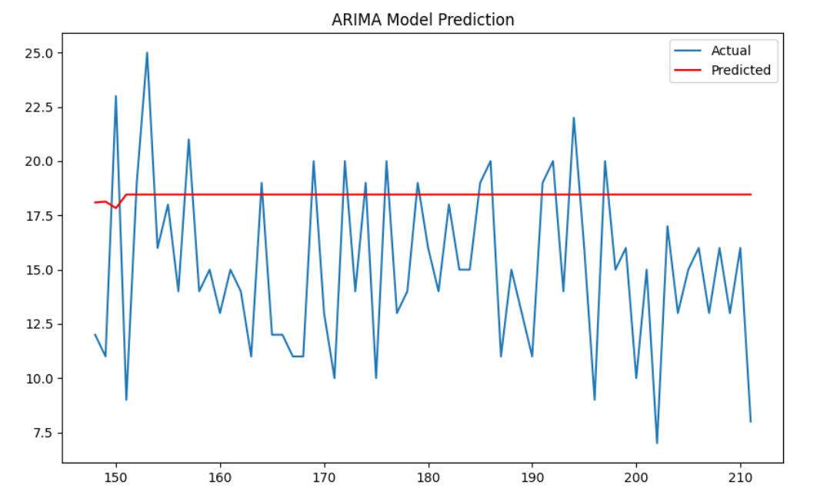
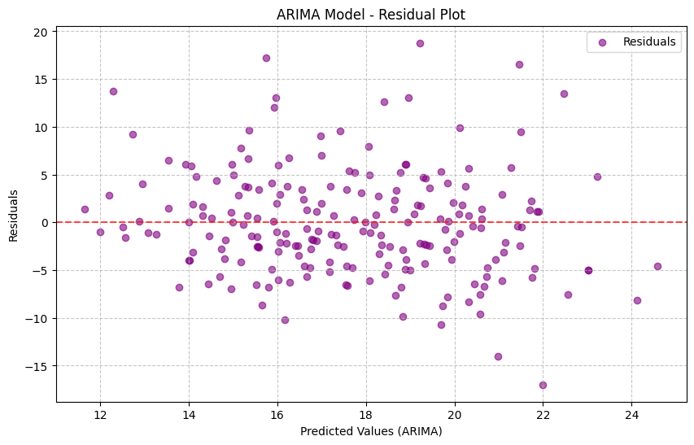
Model 3: ARIMA (Autoregressive Integrated MA)
The ARIMA model's hyperparameters were fine-tuned to find the optimal configuration for accurate forecasting.
After testing multiple combinations of parameters (p, d, q), the best model was identified with parameters (p=1, d=1, q=2), resulting in the lowest Root Mean Square Error (RMSE) of 5.5470
The ARIMA model was used to predict daily values based on the optimized parameters.
Key Insight: The ARIMA model accurately tracks daily trends and seasonal fluctuations, with some deviations between predicted and actual values.
Predictions were aggregated on a weekly basis to capture longer-term trends. The ARIMA model displayed a reasonable fit, though some periodic divergences were observed.
The residuals plot was used to check for randomness between actual and predicted values. A relatively random distribution around zero indicated that most patterns were captured by the model.
Key Insight: While the model performed well, some small patterns remained unexplained, suggesting that more complex seasonality or external factors could improve the model.

Slide 13
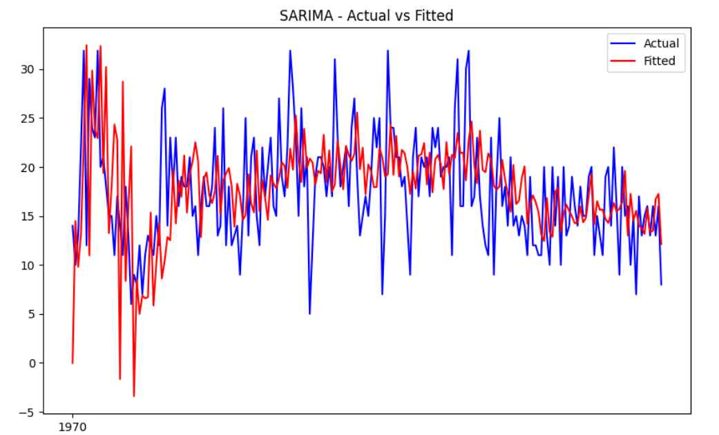
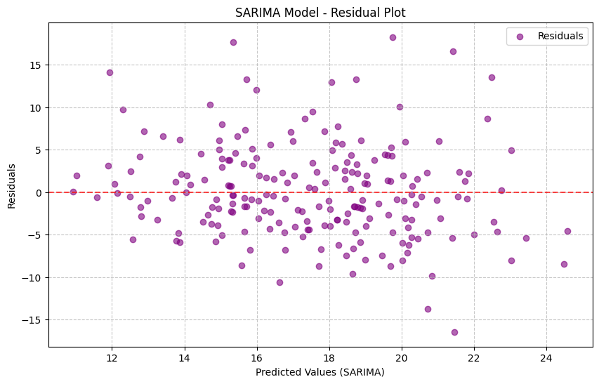
Model 4: SARIMA (Seasonal ARIMA)
Various combinations of seasonal and non-seasonal parameters (p, d, q) and (P, D, Q) were tested to find the optimal configuration. The best-performing model was identified with parameters (p=2, d=1, q=2), (P=2, D=0, Q=2, s=12), yielding an RMSE of 5.5235. This fine-tuning process helped improve the model’s accuracy.
The SARIMA model successfully captures daily fluctuations and seasonal patterns, providing accurate forecasts with minor deviations between predicted and actual values.
The SARIMA model excels in capturing longer-term trends and seasonality in the weekly data, showing good alignment with actual values, though small discrepancies appear during specific periods.
The residual plot indicates that the model effectively captures most patterns with minimal systematic bias. There are no significant outliers, suggesting that the model has adequately explained the variance in the data.

Slide 14
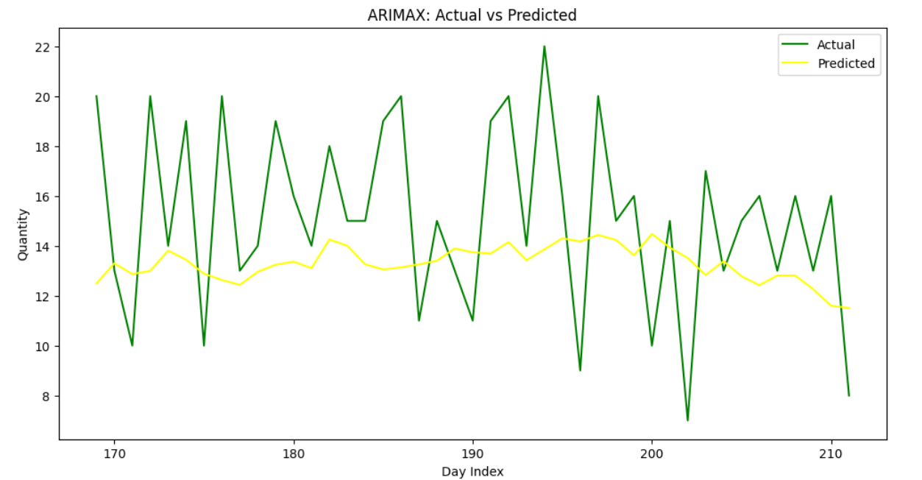
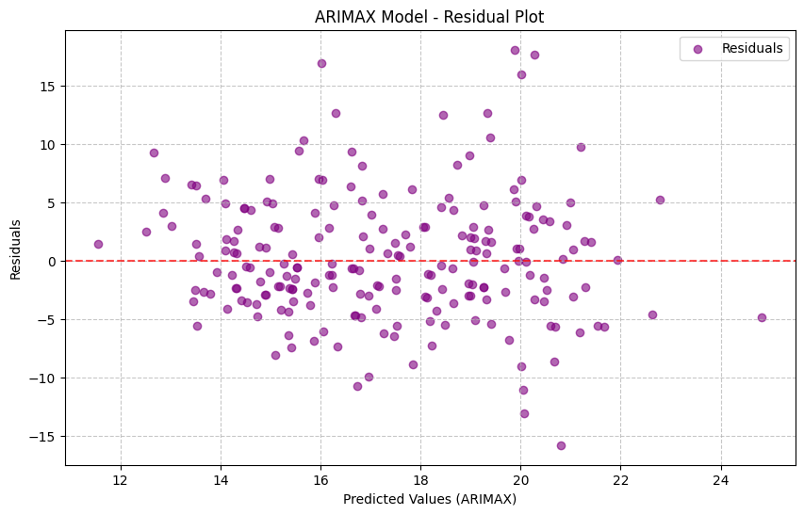
Model 5: ARIMAX (ARIMA with Exogenous Variables)
After testing various (p, d, q) combinations, the best parameters were (2, 1, 2) with an RMSE of 5.3600, resulting in the most accurate predictions. The SARIMA model successfully captures daily fluctuations and seasonal patterns, providing accurate forecasts with minor deviations between predicted and actual values.
The ARIMAX model closely tracks daily trends, though minor deviations appear during sharp fluctuations. The addition of exogenous variables helps the model adjust to these variations.
The residuals plot shows that the model has minimal systematic bias, indicating that it fits the data well with no significant error patterns.

Slide 15
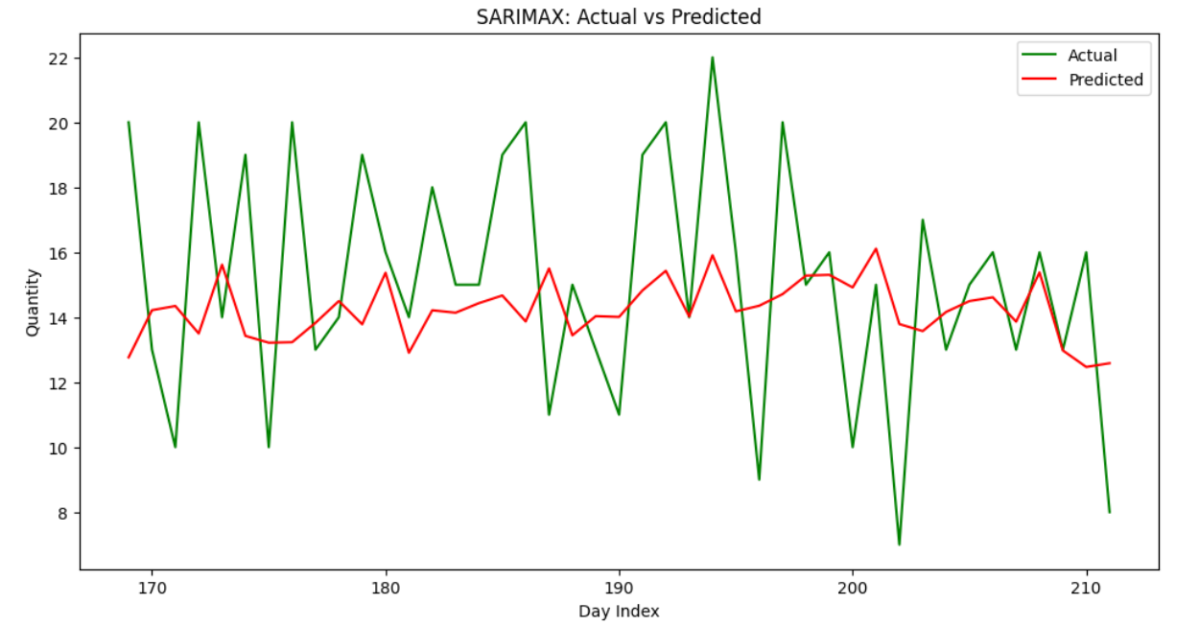
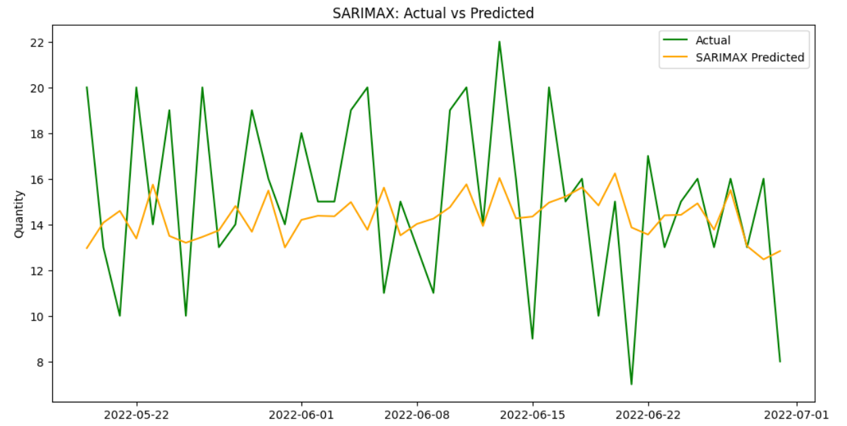
Model 6: SARIMAX (Seasonal ARIMAX)
After extensive testing, the best SARIMAX parameters were identified as (1,1,2,0,1,1,7) with an RMSE of 3.707. The SARIMAX model closely tracks daily trends, though minor deviations appear during sharp fluctuations. The addition of exogenous variables helps the model adjust to these variations.
After tuning, the SARIMAX model was refitted, and predictions for daily values were generated and compared to actual data. The SARIMAX model closely tracks daily fluctuations, with a minor lag during certain peak periods.

Slide 16
Insights and Conclusion
After evaluating all the models, the SARIMAX model emerged as the most suitable choice for this project:
Seasonality Capture: It effectively captures seasonality, essential for predicting recurring demand patterns.
Incorporation of Exogenous Variables: It integrates key external factors like Clicks and Impressions, which influence the target variable (Quantity).
Superior Accuracy: Compared to simpler models (AR, MA), SARIMAX consistently showed higher accuracy and a more comprehensive data understanding.
Conclusion: SARIMAX meets the project’s forecasting needs, making it the recommended approach for reliable time series analysis and demand prediction.

Slide 17
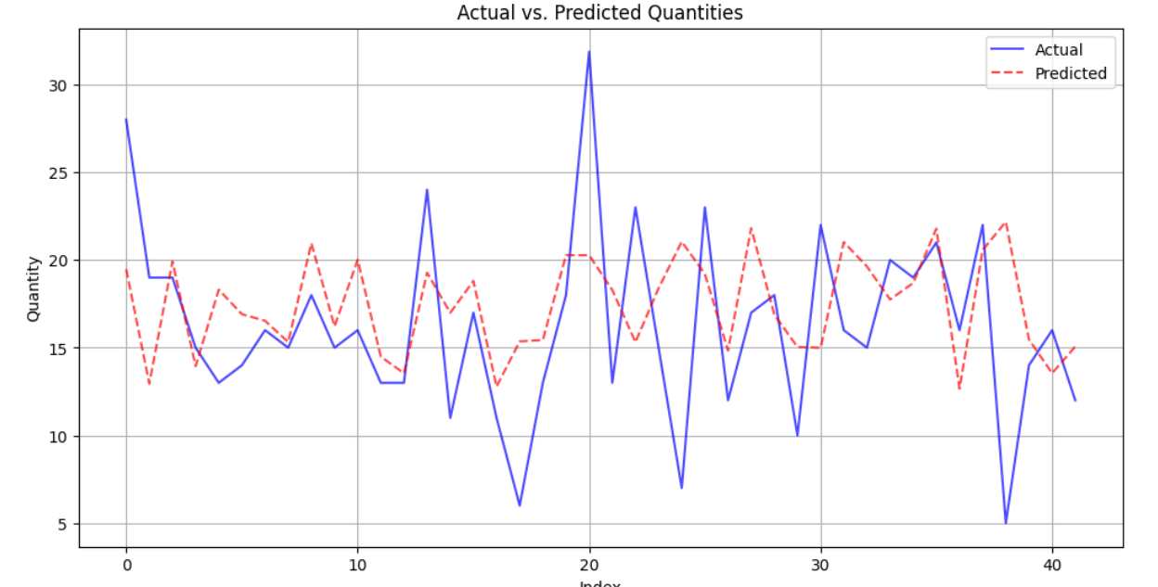
Final Step: Splitting Data and Running Multivariate Regression with Visualization
Hyperparameter Tuning: The multivariate regression model's hyperparameters were fine-tuned using GridSearchCV to optimize parameters such as fit_intercept and copy_X. After testing multiple configurations, the best model was identified with parameters {'copy_X': True, 'fit_intercept': True}. The evaluation metrics showed an RMSE of 5.50 and an R-squared value of -0.069.
The multivariate regression model was used to predict daily values based on the tuned parameters. Key Insight: The model captures daily fluctuations but struggles with significant spikes, leading to slight discrepancies between predicted and actual values.

Slide 18
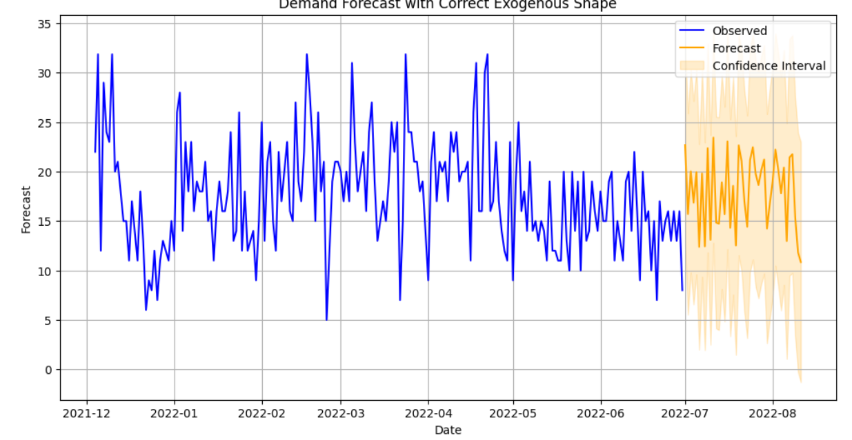
Forecasting using sarimax
The model was used to generate predictions for the next six months based on simulated future values of exogenous variables (Clicks and Impressions).
Key Insight: The model forecasts a significant increase in the predicted quantity during the initial months, followed by a stabilization. While the trend generally follows expected patterns, further refinement is needed for more precise forecasting.

